Slide 1
Paguda
Forecast and weather information with public api
Manolescu Mihai Alexandru

Slide 2
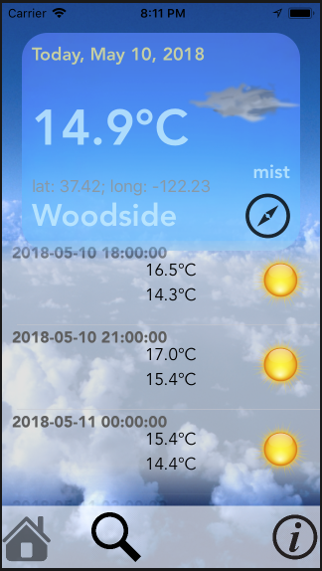




Platform: iOS
Language: Swift 4
Frameworks: Alamofire
Public API: openweathermap.org

Slide 3
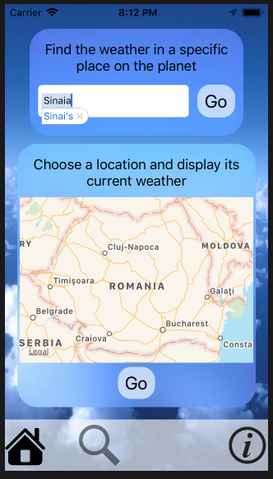
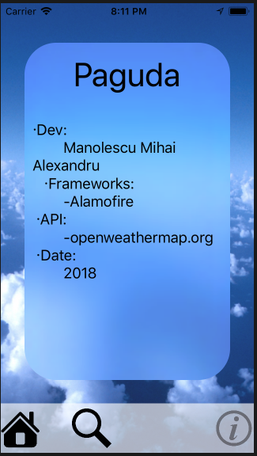
UX

Slide 4

An app that displays weather information and forecast in real time for the current location from GPS. The user can also get the forecast for any other location, just by searching the name of the city.

Slide 5
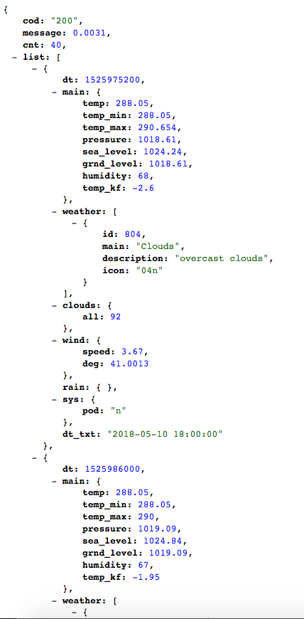
One of the best way to communicate with an external database is throug JSON objects. The popularity and ease of its structure offers an indeal solution for many app specifications. The fact of matter is nowadays many companies offer public APIs with free copyright, especially in non-comercial conditions. This example presents a demonstration with API of 'free license' .

Slide 6
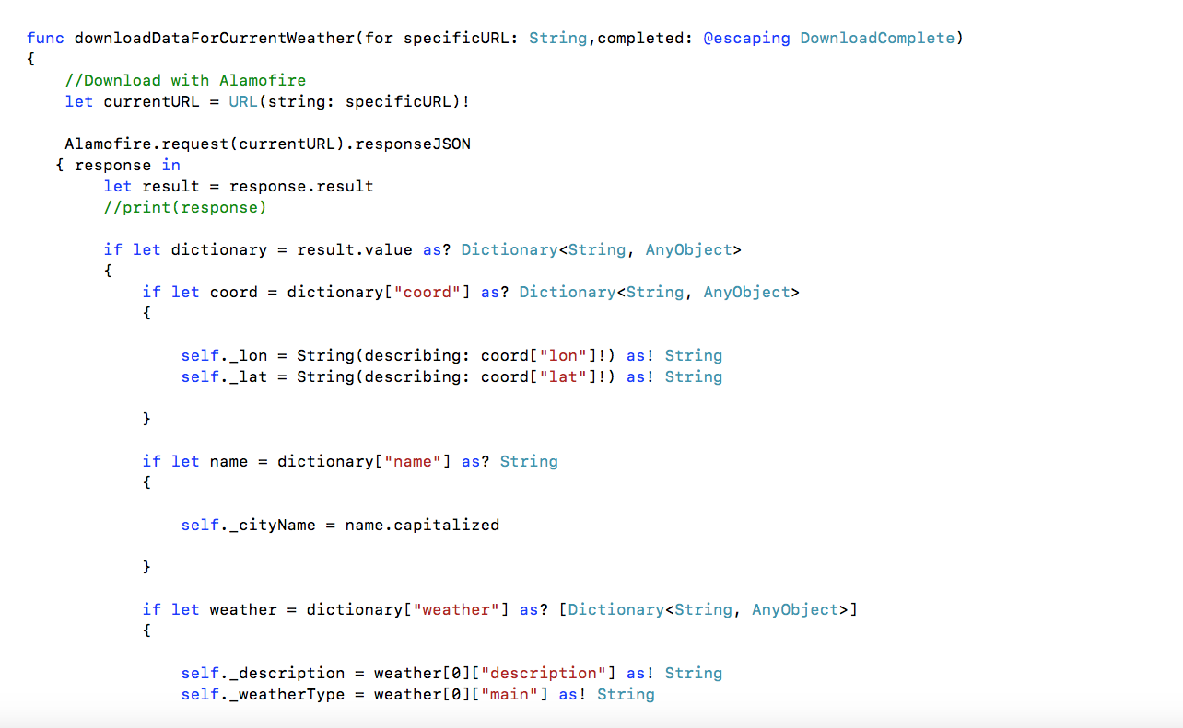
Fetching the JSON objects with a 'completion handler' is a must-have in a such communication channel, since we also want to make sure all the data gets downloaded. Also, the security restrictions (allowArbitratyLoads variable, set to true) have to be turned to off, because the iOS architecture won't allow any download connection excepting the ones offered by the built-in functionalities.

Slide 7
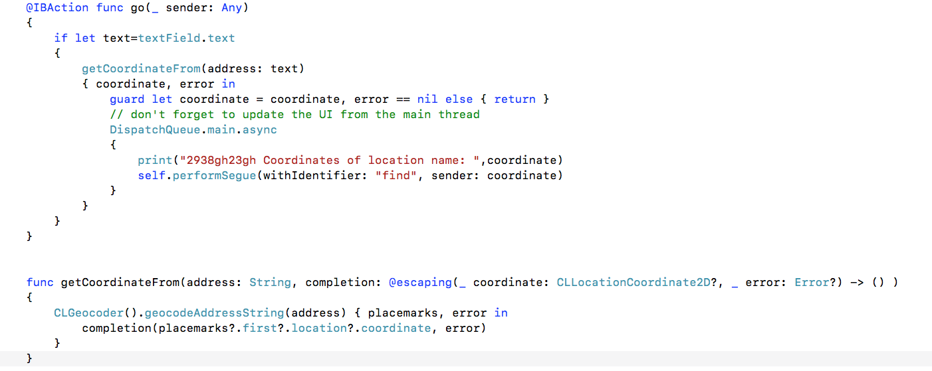
Swift always gives us a hand when needed, and offers us a special feature that uses a string as parameter (the name of the location) and returns the coordinates of the specific location.

Slide 8
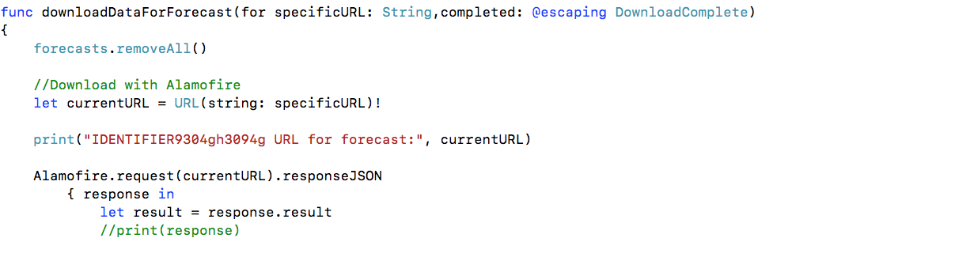
The homogeneity of the data flow is possible throug the special variable CLLocationCoordinate2D, that allows us to manipulate the coordinates and its components individually.
After getting the coordinates components from CLGeocoder().geocodeAddressString(address) we are ready for the API call.

Slide 9
I would honestly like to thank:
-prof Iuliana Marin
-Conf dr. ing. Andrei VASILĂŢEANU
-Conf dr. Maria DASCĂLU
-Prof. dr. ing. Nicolae GOGA
-Asist. dr. ing. Alexandru MITREA – secretar
-Apple, Alamofire, internet provider
-God
-UPB
And special appreciation and gratitude for AVP company.

